Slide 1


Sales Forecast By Season
Dec 16, 2017
SEIS 763 Machine Learning
July 18, 2018

Slide 2
Problem Overview
We are planning to study the relationship between various factors in sales data to predict which categories of items will be sold in which part of the year.
Knowing which items are more likely to be sold will help in understanding the demand and supply relationship of the items.
SEIS 763 Machine Learning
July 18, 2018

Slide 3
Data Overview
Item_category.csv
Item_id
Category id
Category name
Item type
Sales _train.csv
Date
Shop id
Item id
Item price
Item_cnt_day
Data block num
shops.csv
shop_id
Shop name
City
Items.csv
Item_id
Item name
SEIS 763 Machine Learning
July 18, 2018

Slide 4
Data Pre-processing
Translated Russian item names/categories into English for better understanding.
Down sample the records to 50K by:
  Focusing on the categories of items sold by just one shop of a particular city instead of focusing on the shops spread across the country.
  Grouped the rows of particular items by aggregating the items count sold per day into items count sold per month and added this new predictor – item count per month.
Converted Date into month , weekday and year.
Created target variable – season (Binary class classification )
      Class 1 -> Q1-Q2 , Class 0 -> Q3-Q4
Created dummy variables of categorical items and performed standardization on numeric variables .
SEIS 763 Machine Learning
July 18, 2018

Slide 5
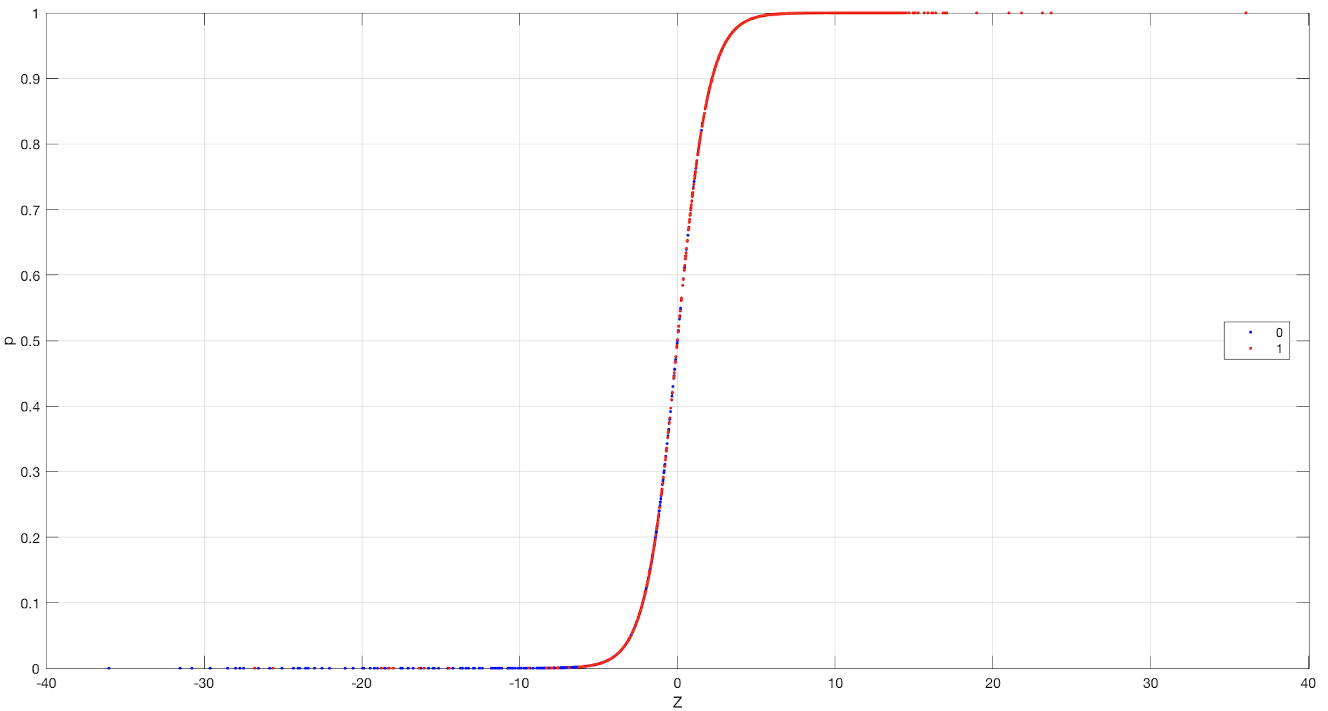
Visualizing dataset
SEIS 763 Machine Learning
July 18, 2018

Slide 6
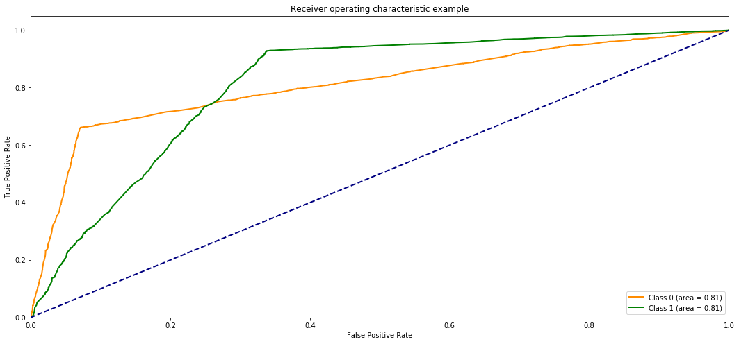
Model 1 : Logistic Regression
Classification Report: Confusion Matrix:
 | precision | recall | f1-score | support
0 | 0.76 | 0.66 | 0.71 | 2639
1 | 0.89 | 0.93 | 0.91 | 7541
avg/ total | 0.85 | 0.86 | 0.86 | 10180
 |  | Predicted
True Label | Class 0 | 1748 | 891
 | Class1 | 560 | 6981
Accuracy: 0.85
Execution time : 0:00:02.660459
MSE: 0.14
Variance score: 0.26
C=100
AUC: 0.811
SEIS 763 Machine Learning
July 18, 2018

Slide 7
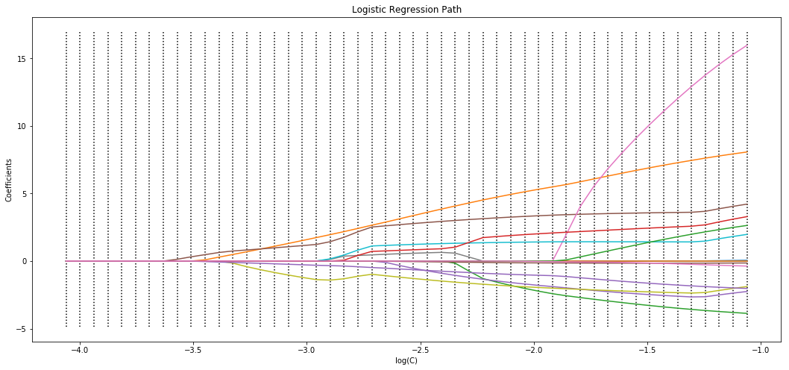
Model 1 : Logistic Regression
C = 0.0001 | log ( C ) = -3.019 | Accuracy = 82% | AUC = 0.79 | F1 – Class0 = 0.56 | F1 – Class1 = 0.89
C = 0.003 | log ( C ) = -2.53 | Accuracy = 84% | AUC = 0.81 | F1 – Class0 = 0.65 | F1 – Class1 = 0.90
SEIS 763 Machine Learning
July 18, 2018

Slide 8
Model 1 : Continue
item_category_Accessories | item_category_Battery | item_category_Books | item_category_Cinema | item_category_Game Consoles | item_category_Games | item_category_Gifts | item_category_Music | item_category_Office | item_category_Official | item_category_Programs | Item Type_Electronics | item_price_s | item_cnt_month_s | Sales_vol_s
-2.258567 | 1.03384 | -1.170999 | 5.626222 | 23.479956 | 2.155964 | -0.692562 | 3.30323 | -5.53256 | 0.649891 | 6.070438 | 2.760509 | -2.384951 | -0.119105 | -0.605403 | -1.978311
-1.684643 | 1.613202 | -1.162468 | 5.63488 | 24.0565 | 2.730191 | -0.684017 | 3.311898 | -5.534339 | 2.449406 | 6.645402 | 2.195062 | -2.38509 | -0.119047 | -0.605547 | -1.986918
-4.350304 | 0.0 | -1.216789 | 5.546083 | 20.755922 | 0.0 | -0.748274 | 3.232006 | -2.68147 | 0.0 | 3.771448 | 4.808329 | -2.343659 | -0.122037 | -0.579521 | -1.900944
the c = 1000, c= 10000, c= 1
When C is greater than 0.03, the results do not change.
Score in 10 CV under C= 10000 [0.78337147,0.94279176,0.97635393,0.97635393,0.97736521,0.98041709,0.97456765,0.97608751,0.97990333,0.97303485]
SEIS 763 Machine Learning
July 18, 2018

Slide 9

Model 2 : Random Forest
Class 0 Prediction |  | Predicted
True Label | Class 0 | 1746 | 893
 | Class1 | 716 | 6825
Accuracy: 84%
Execution time : 0:00:03.660459
MSE: 0.16
Classification Report:
 | precision | recall | f1-score | support
0 | 0.71 | 0.66 | 0.68 | 2639
1 | 0.88 | 0.91 | 0.89 | 7541
avg/ total | 0.84 | 0.84 | 0.84 | 10180
SEIS 763 Machine Learning
July 18, 2018

Slide 10
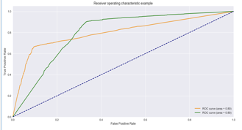
Model 2 : Random Forest
SEIS 763 Machine Learning
July 18, 2018

Slide 11
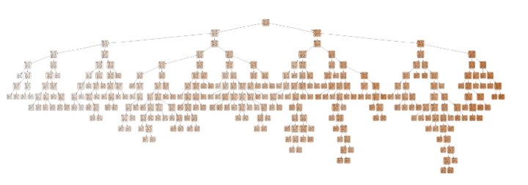
Model 2 : Random Forest
SEIS 763 Machine Learning
July 18, 2018

Slide 12
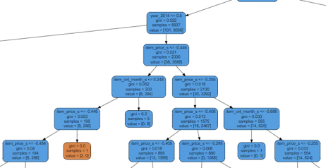
Model 2 : Random Forest
SEIS 763 Machine Learning
July 18, 2018

Slide 13
Model 3 : SVM (Linear Kernel)
# Tuning hyper-parameters for precision
tuned_parameters =
[{'kernel': ['linear'],
'C': [1, 10, 50, 100, 300, 500, 800, 1000]}]
SEIS 763 Machine Learning
July 18, 2018
Notes:
.

Slide 14
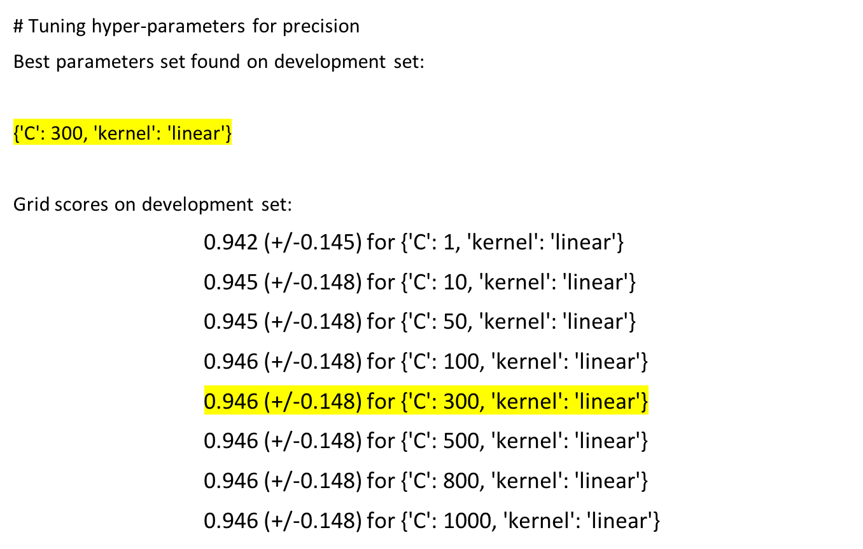
Model 3 : SVM (Linear Kernel)
SEIS 763 Machine Learning
July 18, 2018
Notes:
.

Slide 15
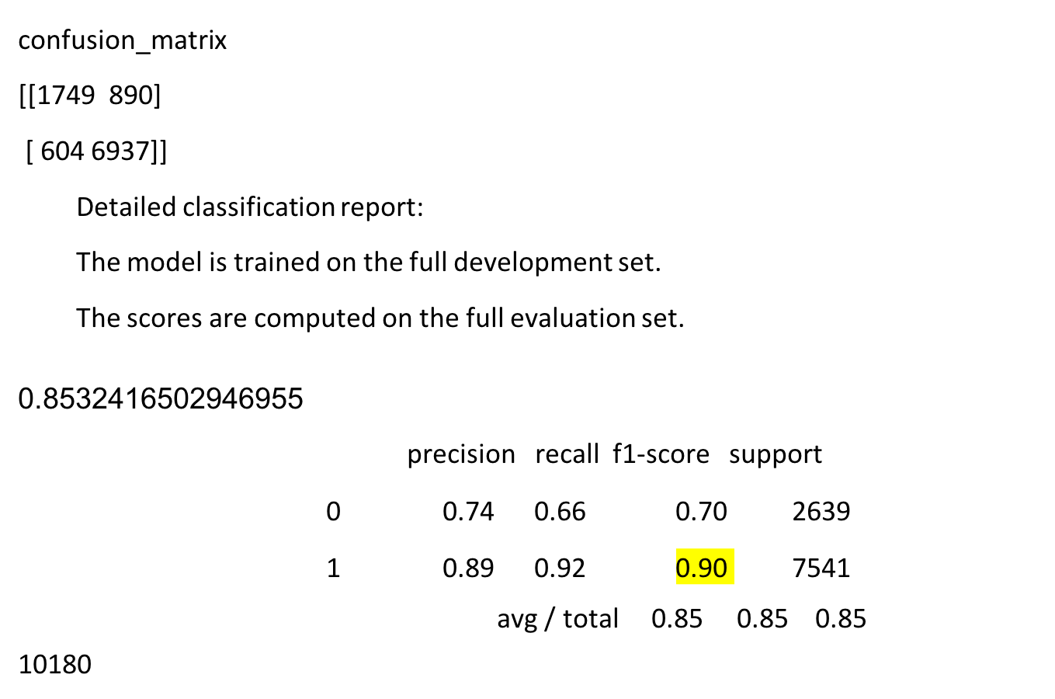
Model 3 : SVM (Linear Kernel)
SEIS 763 Machine Learning
July 18, 2018
Notes:
.

Slide 16
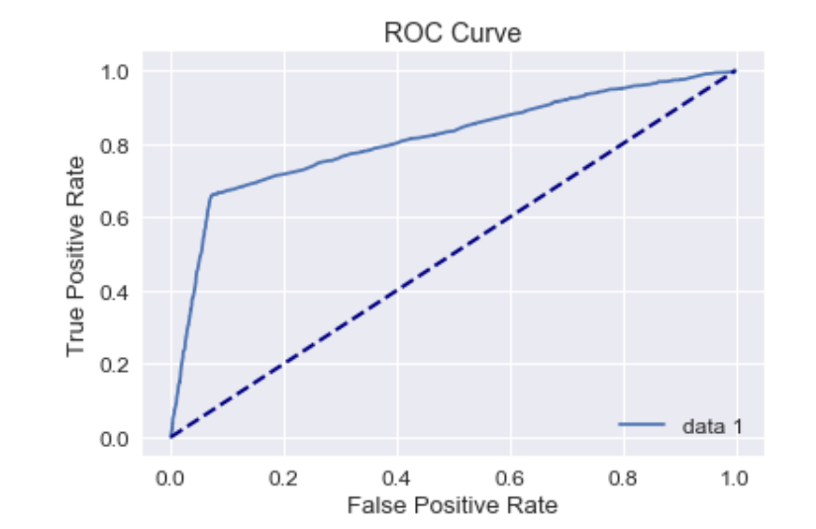
Model 3 : SVM (Linear Kernel)
(ROC) (X_test)[::,0]
SEIS 763 Machine Learning
July 18, 2018
Notes:
.

Slide 17
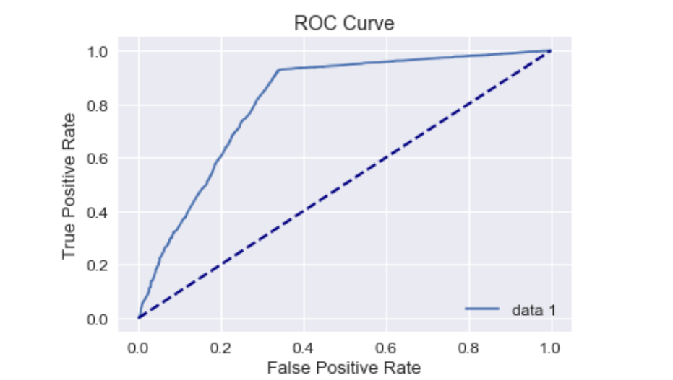
Model 3 : SVM (Linear Kernel)
(ROC) (X_test)[::,1]
SEIS 763 Machine Learning
July 18, 2018
Notes:
.

Slide 18
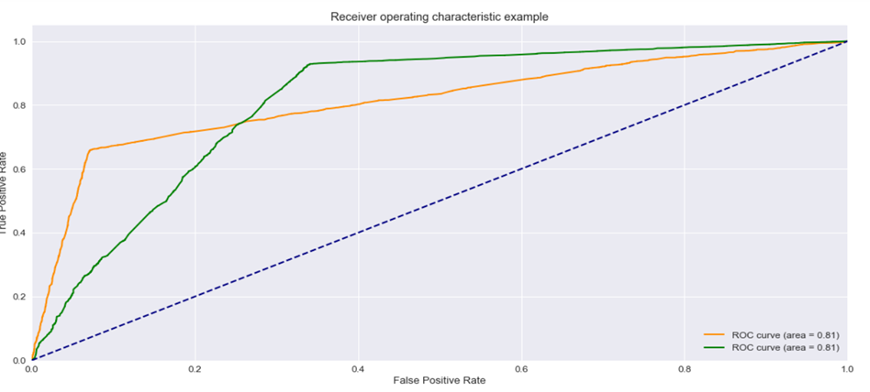
Model 3 : SVM (Linear Kernel)
(ROC) (X_test)[::,1] and (X_test)[::,0]
SEIS 763 Machine Learning
July 18, 2018
Notes:
.

Slide 19
Model 3 : SVM (Linear Kernel)
(AUC)
(X_test)[::,1](X_test)[::,0]
0.8122147367788439
SEIS 763 Machine Learning
July 18, 2018
Notes:
.

Slide 20
ROC AUC Curve
Logistic Regression. Random Forest SVM
SEIS 763 Machine Learning
July 18, 2018
Notes:
This is the ROC AUC curve.
As you can see they are relatively well performing, though far from perfect.
Though their difference is slight, that difference is probably significant.

Slide 21
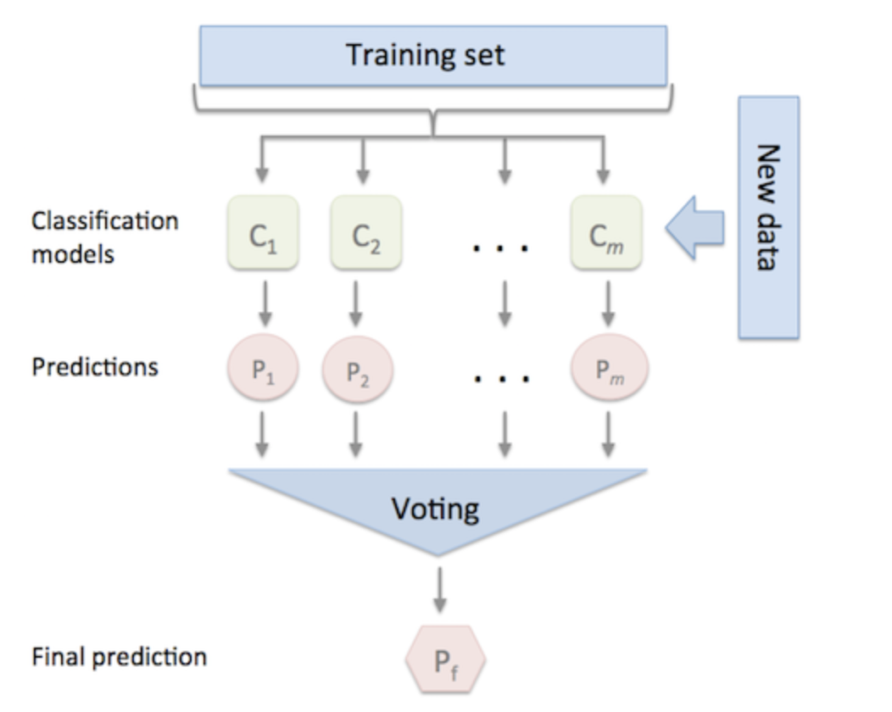
Ensemble
Classification models:
Logistic Regression
Random Forest
SVM
Voting using
sklearn - Voting Classifier:
Hard Voting
Soft Voting
SEIS 763 Machine Learning
July 18, 2018

Slide 22
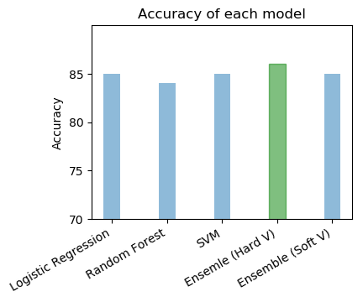
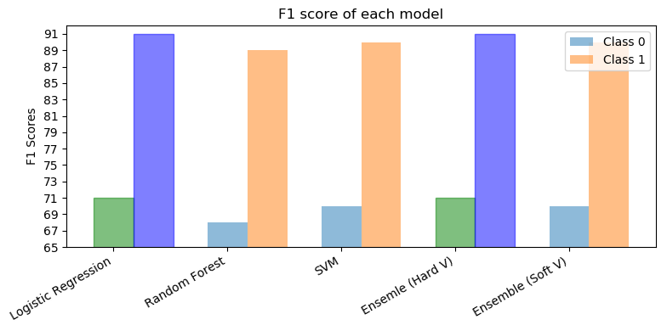
Visualizing Quality Parameters
Some of the important Predictors –
Gifts (Soft Toys, Souvenirs, Games) ->> Class 0 [Q3-Q4]
Cinema (DVDs , BlueRay 3D ) ->> Class 1[ Q1-Q2]
SEIS 763 Machine Learning
July 18, 2018

Slide 23
Comparisons of Models
Model | Logistic Regression | Logistic Regression | Random Forest | Random Forest | SVM | SVM | Ensemble Hard V | Ensemble Hard V | Ensemble Soft V | Ensemble Soft V
Classes | Class0 | Class1 | Class0 | Class1 | Class0 | Class1 | Class0 | Class1 | Class0 | Class1
Training time | 0:00:02.66 |  | 00:02:03 |  | 0:30:00.00 |  | 00:33:00 |  | 00:33:00
F1 Score | 0.71 | 0.91 | 0.68 | 0.89 | 0.70 | 0.90 | 0.71 | 0.91 | 0.7 | 0.9
Precision | 0.76 | 0.89 | 0.71 | 0.88 | 0.74 | 0.89 | 0.76 | 0.89 | 0.75 | 0.88
Recall | 0.66 | 0.93 | 0.66 | 0.91 | 0.66 | 0.92 | 0.66 | 0.93 | 0.65 | 0.92
Accuracy | 85 |  | 84 |  | 85 |  | 86 |  | 85
AUC Score | 0.811 | 0.811 | 0.80 | 0.80 | 0.81 | 0.81
Confusion Matrix
TP FN | 1748 | 891 | 1746 | 893 | 1749 | 890 | 1735 | 904 | 1721 | 918
FP TN | 560 | 6981 | 716 | 6825 | 604 | 6937 | 545 | 6996 | 566 | 6975
SEIS 763 Machine Learning
July 18, 2018
Notes:
Nikhil? Neo?

Slide 24

Thank You
SEIS 763 Machine Learning
July 18, 2018

